Slide 1
KPMG cities taking over
Learning by Play
Group 4 | Aniek Berendsen | Eddy Bertoluzzo | Paul Dezentje
Dirk Guijt | Christos Frioussios | Nathan Chandrasekaran Ayyanathan

Slide 2
Presentation outline
KPMG
As is situation at KPMG
Desired situation at KPMG
The Game for KPMG
Minigames – Actual Trainings
The concept
Next steps
Game technology
Prototype
Questions & Remarks

Slide 3
KPMG
KPMG The Netherlands, international KPMG network
Hundreds of global offices, up to 8 departments per office
Leading in audit, tax and advisory services
Importance of risk management within KPMG
Trainings of Global quality and risk management group
Average 5 trainings per year, up to 20 of even more
Mandatory for all ‘client-facing professionals’
Notes:
KPMG The Netherlands, international KPMG network
Hundreds of global offices, up to 8 departments per office
Leading in audit, tax and advisory services
Importance of risk management within KPMG
Trainings of Global quality and risk management group
Average 5 trainings per year, up to 20 of even more
Mandatory for all ‘client-facing professionals’

Slide 4
As is situation at KPMG
Problemsituation:
Employees are not motivated to learn but just perform trial & error on the exam
Research question:
How can KPMG trainings on legislation, risk and compliance become fun and effective in order to motivate employees to learn, without losing training content and high costs, while being time effective?
Notes:
Trainings are:
Mandatory to pass the test
Employees (can) skip trainings and go directly to final exam
Final exam can be done unlimited number of times
Problemsituation:
Employees are not motivated to learn but just perform trial & error on the exam
Research question:
How can KPMG trainings on legislation, risk and compliance become fun and effective in order to motivate employees to learn, without losing training content, high costs and ?

Slide 5
Desired situation at KPMG
Trainings should:
Be fun
Motivate employees to learn the content
Educate annual required knowledge
Educate specific knowledge
Challenge employees to improve their performances
Create competition between departments, offices

Slide 6
The Game for KPMG
The current objective is to develop a playable concept game, which offers multiple trainings and/or scenarios.
After internal final decision making, based on the concept game, the long term objective is to have the game further developed by the game industry to a full game and launch it on a global scale.

Slide 7
Minigames Actual trainings
Working on the gameplay design
Annual and specific knowledge trainings
Example Black story
Interactive story of 10 minutes
Some questions
consequences
Notes:
First mini-game concept
A story is told using an interactive story. Then in some questions, the player has to decide how to react after that situation. After those questions the consequenses will be shown in a cut-scene to give feedback.

Slide 8
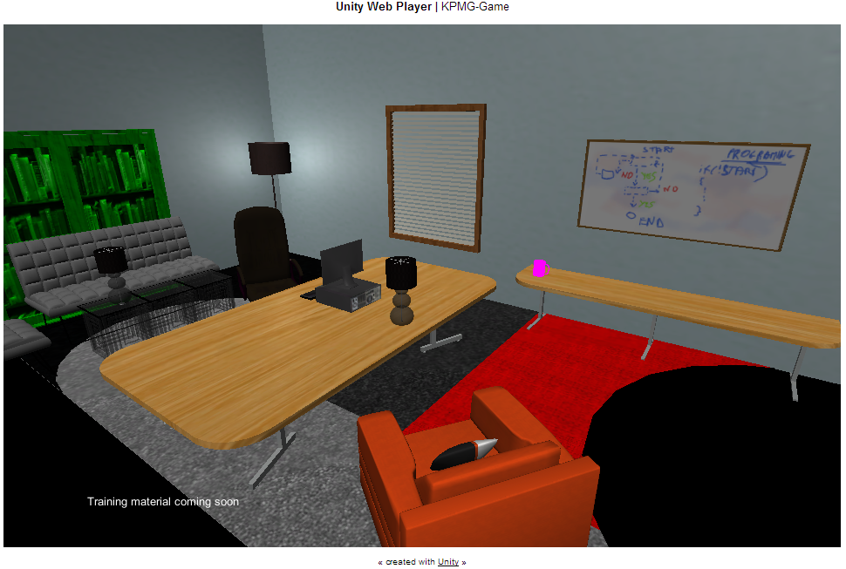
The Concept Office
Notes:
Player controls its own neighbourhood
Each building represents one training (5 – 20 buildings)
The height of the building represents the trainings score (0 - 100%)
Each buildings has several offices, each office contains a training level (minigames)
Great performances are rewarded with bonus trophies “Maximum score”, “Passed in 1” displayed within the office

Slide 9
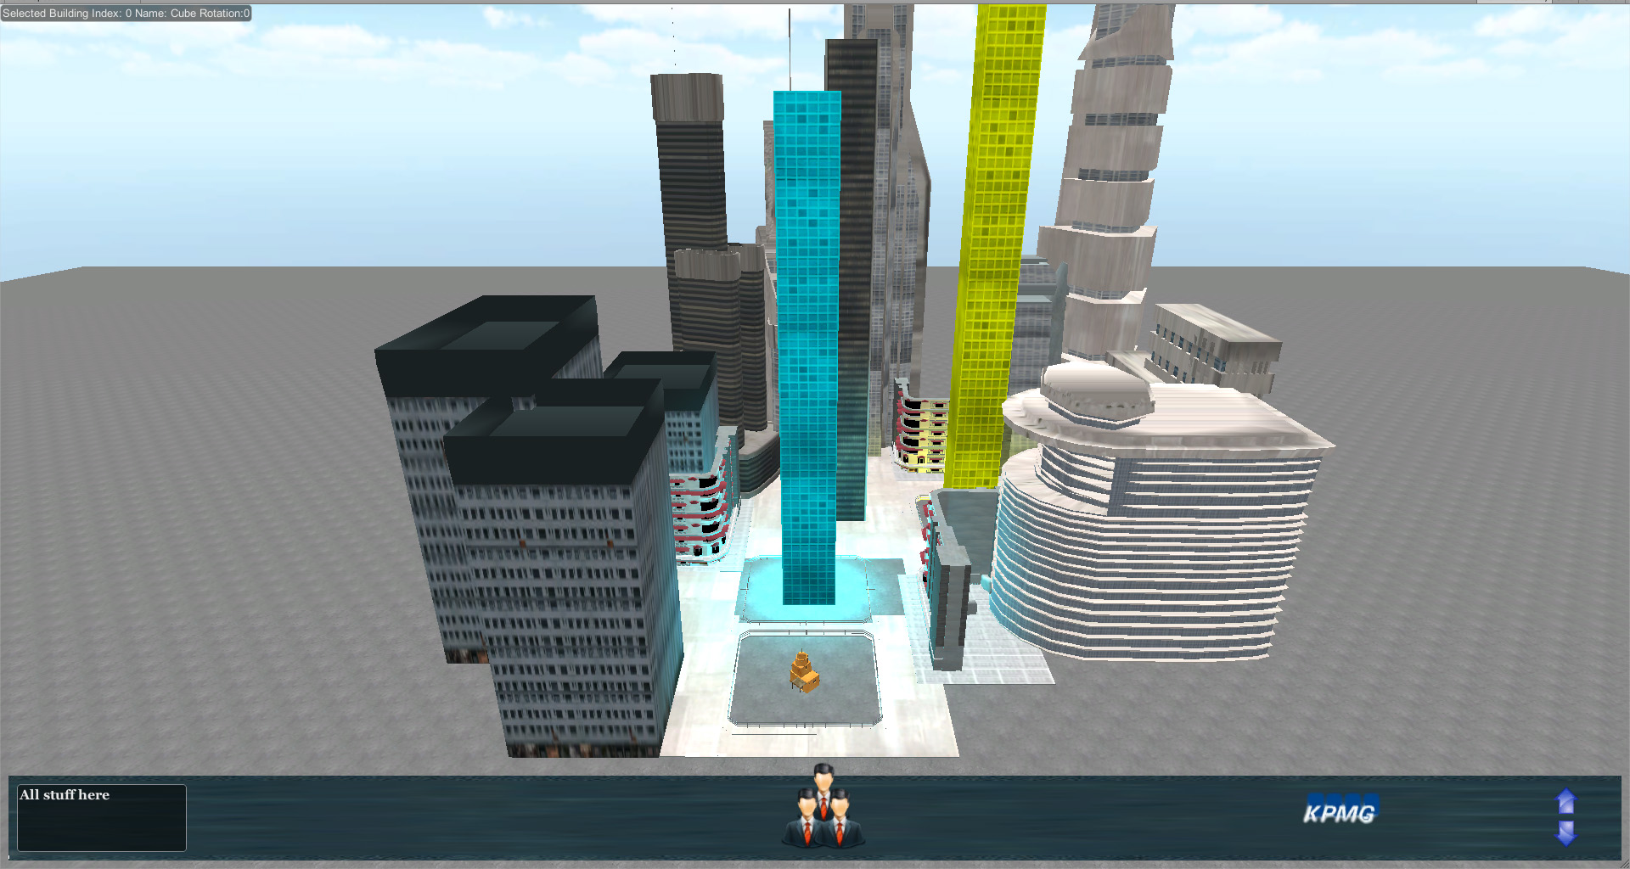
The Concept Neighbourhood | District
Notes:
Players performances in the neighbourhood are summed in a district
Each building in a district represents one training (5 – 20 buildings)
The height of the building represents the average trainings score of the players of a department (0 - 100%)
Players can only click on their own neighbourhood, not view others
Players can not look into an office from this view
The department performances are summed in a city, representing the performances of one office, for example KPMG Amstelveen
Each city has maximal 8 districts (departments), each which 5 – 20 buildings representing the training topics
The height of the building represents the average trainings score of the players of a department (0 - 100%)
Players can only click on their own department, not view others
Players can not look into an office from this view

Slide 10
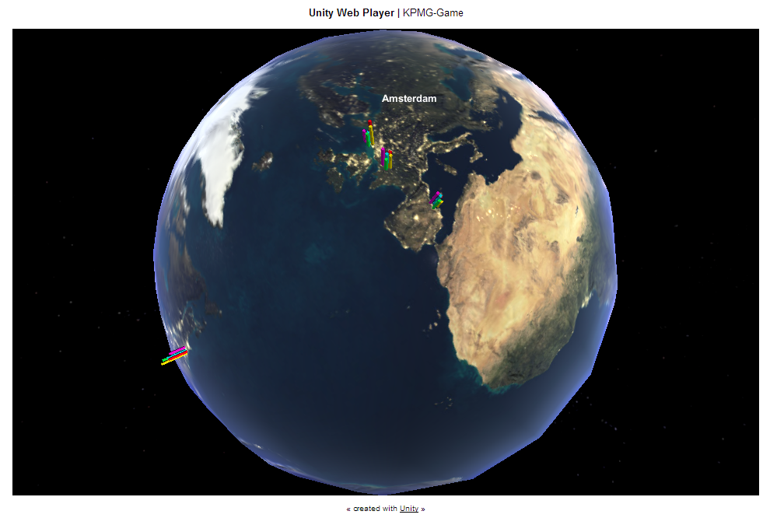
The Concept City | Global
Notes:
The performances of offices in the Netherlands are summed in a total score of the Netherlands
The scores can be compared per country on a global level
Each country contains the 5-20 buildings, representing the countries score on a topic
Players can only compare other countries on a national level, not on an office level

Slide 11
Summarizing the Concept
Player controls his own neighbourhood
Neighbourhood contains topic-buildings
Grow through high scores
Buildings contain offices, in which mini-games are about legislation, compliance and risk management + test
Competition on different layers, representing KPMG hierarchy
Neighbourhood Employees performances
District Department
City Office KPMG Amstelveen
(Country KPMG The Netherlands)
Global KPMG international

Slide 12
Next Steps
Designing and programming mini games (actual trainings)
Optimizing layers in worldview
Testing & validating
Game manual
Technical report
Release prototype & final presentation
Notes:
AANPASSEN NA EDDY

Slide 13
KPMG Cities Technology
Client and Back-end
Front-end: Web Browser Application
Back-end: KPMG’S Server Infrastructure
Communication: Web Services
Engine: Unity Engine
Flexible
Documented and Supported
Further Development

Slide 14
The prototype
KPMG Cities

Slide 15
Questions & Remarks

